Slide 1
Seminar – I (January 29, 2021)
Investigating plasma instabilities using computer simulation.
By Eric Fernando|B9TB1707
Ohnishi|Takahashi Laboratory

Slide 2
What is Plasma?
Plasmas are often described as the fourth state of matter, alongside gases, liquids and solids.
The two main properties that defines plasma are:
Quasi-neutrality: Even though plasma consists of individual charged particles, the plasma body as whole is almost neutral (quasi-neutral).
Collective behavior: The each particle’s fields affect each and every other particle giving rise to collective particle dynamics that is very different from its constituents. This property of plasma makes it behave in unintuitive ways.

Slide 3
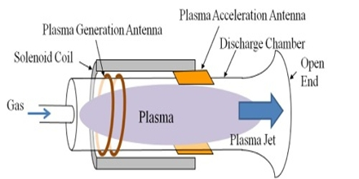
Plasma propulsion engine
The propulsion engineering lab explores the properties of high-temperature gases or plasmas are investigated for applications in novel propulsion systems.
A plasma propulsion engine is a type of electric propulsion that generates thrust from ejecting a plasma beam out the exhaust.
Plasma engines have a much higher specific impulse (I_{sp}) value than most other types of rocket technology.
Ex-astronaut Franklin Chang-Diaz claims a plasma thruster could send a payload to Mars in as little as 39 days, while reaching a maximum velocity of 34 miles per second. This makes plasma thrusters an important technology in coming years.
It is therefore vital that we prevent instabilities from occurring when the plasma is being ejected.

Slide 4
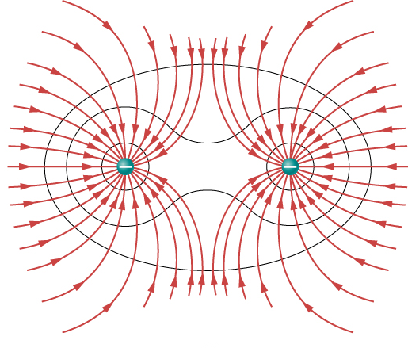
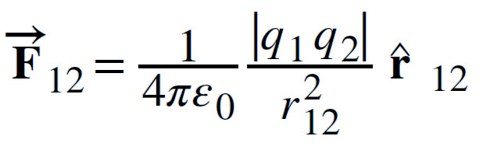
Particle-Particle interaction
What happens when two electrons are placed together?
What happens when two beams(explain beam) of electrons interact with each other?
One would assume they repel each other no matter what; but that is not the case. Studying interaction between two electron beams through computer simulation was my primary focus over the past few weeks, and I would like to share my results.
From Coulombs' Law,
we know that they repel each other.
?
Electron beam 1
Electron beam 2

Slide 5
Objective
To investigate the collective particle dynamics of plasma.
To learn spatial discretization and time stepping algorithms to build a model capable of simulating plasma using the Particle-in-cell technique.
To apply the acquired knowledge, and build an program to simulate the dynamics of the interaction between two electron beams.

Slide 6
The Particle-In-Cell method add picture
Electron density
Weighting to grid points
Electric field and potential and acceleration
Poisson’s Equation
Position and velocity
Leap frog integration
The Particle-In-Cell (PIC) method computes the density and subsequently the potential and electric field on a mesh. Hence it is also called a particle-mesh method. The electric field is then extrapolated to the particles in order to advance them.

Slide 7
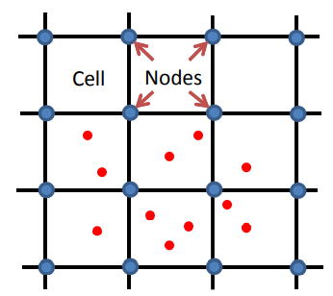
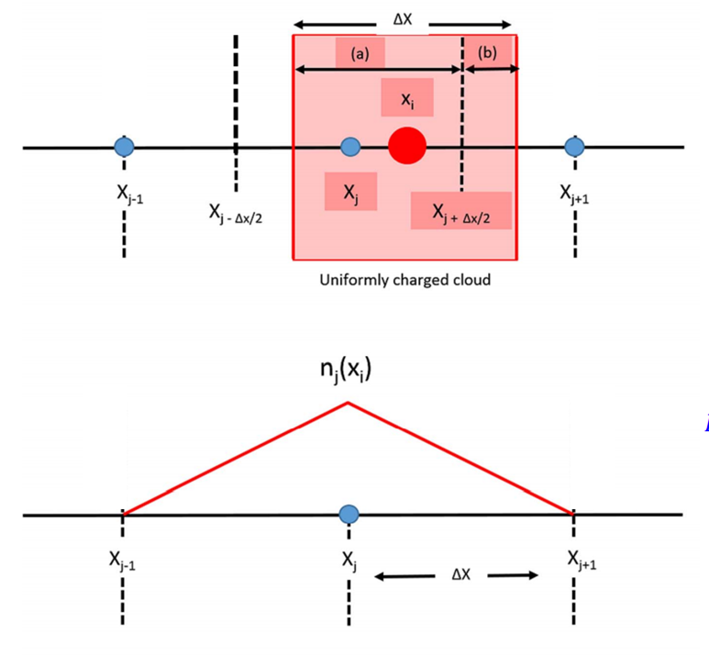

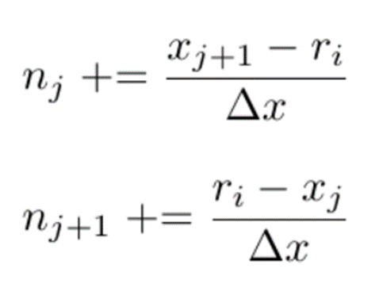
Weighting to grid points.
The density is obtained by binning the particles onto the mesh grid points. Call the separation distance between mesh points Δx. A particle with position rᵢ will lie between a pair of coordinates xⱼ and x_{j+1} on the mesh. Then, the densities nⱼ and n_{j+1} at these two points gain a contribution. (subscript)

Slide 8
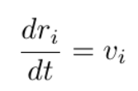
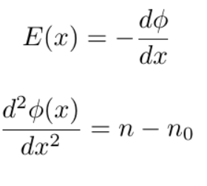
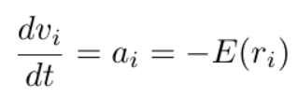
Governing equations
For any simulation a group of governing equations are a paramount. Only with a set of governing equations can we begin to build the algorithm for the simulation.
The equations of motion for the electron is given by
And now the electric field is calculated using the following equations.
Where n-n₀ is the average electron density.
These equations follow from the Poisson’s equation.

Slide 9
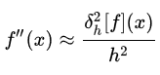
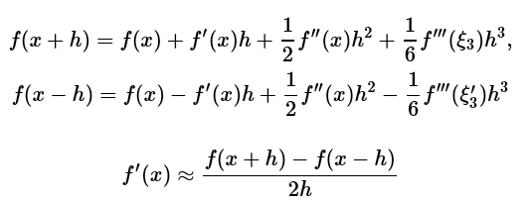
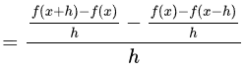
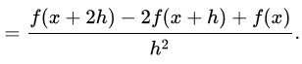
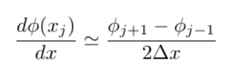
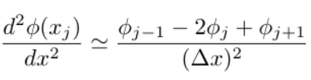
Central difference approximation
We can’t calculate the differentials in a continuous manner as it would be too resource intensive, so we approximate the differential using Taylor’s expansion.

Slide 10
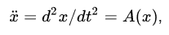
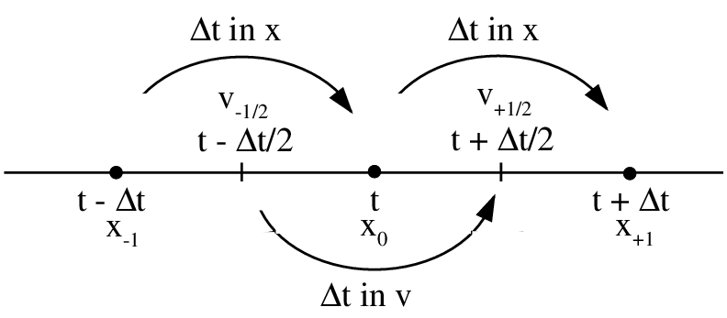
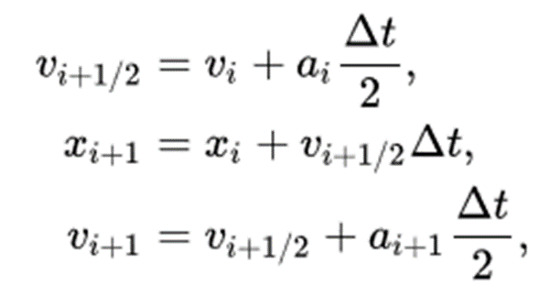
Leap Frog Integration
leapfrog integration is a method for numerically integrating differential equations of the form :
In leapfrog integration, the equations for updating position and velocity are
where x_{i} is position at step i, v_{i}+ 1/2 is the velocity, or first derivative of x, at step i + 1/2 , a_{i} = A ( x_{i} ) is the acceleration, that’s is obtained from electric field obtained from previous steps, and Δ t is the size of each time step.

Slide 11
Two Stream Instability
The stability of a plasma is an important consideration in the study of plasma physics. A plasma instability is a region where turbulence occurs due to changes in the characteristics of a plasma. Some of these instabilities may evolve and propagate through the medium in surprising ways.
Overcoming this instability is one of the major challenges faced by scientists and engineers working on thermonuclear projects, like nuclear fusion using tokomaks.
There are many types of instabilities aside from the two stream instability.

Slide 12
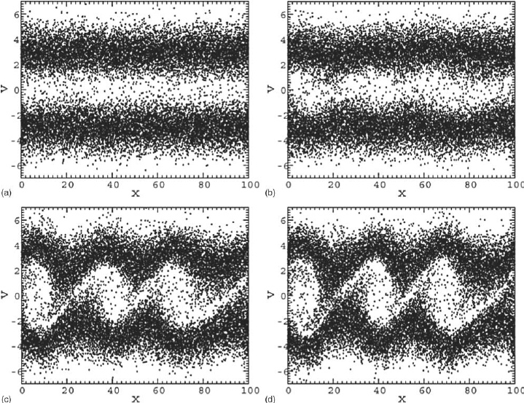
Two Stream Instability
The two-stream instability is one of the most classical examples of velocity space instability that occurs in plasma physics.
Image credit Chi-OK Hwang
In this simulation I have made two electron beams with velocities of same magnitude but opposite direction interact which other.
An initial perturbation is required for the instability to form. In my simulation I have used an sinusoidal perturbation through the electron beam

Slide 13
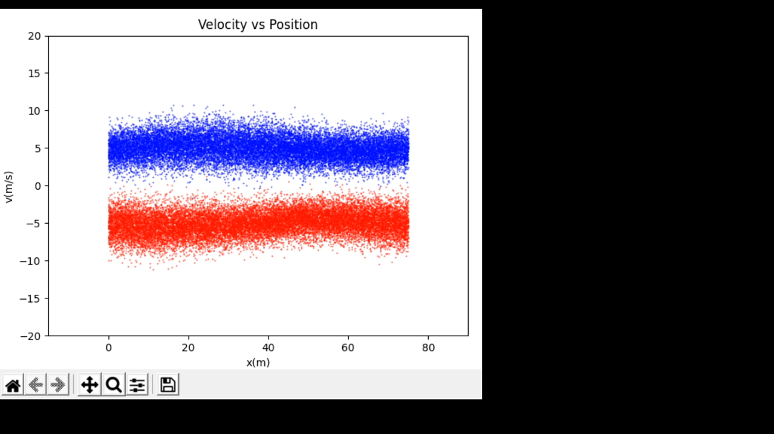
Results: Phase space plot
Each electron plotted in the phase space (position vs velocity)
We can clearly see an instability forming.

Slide 14
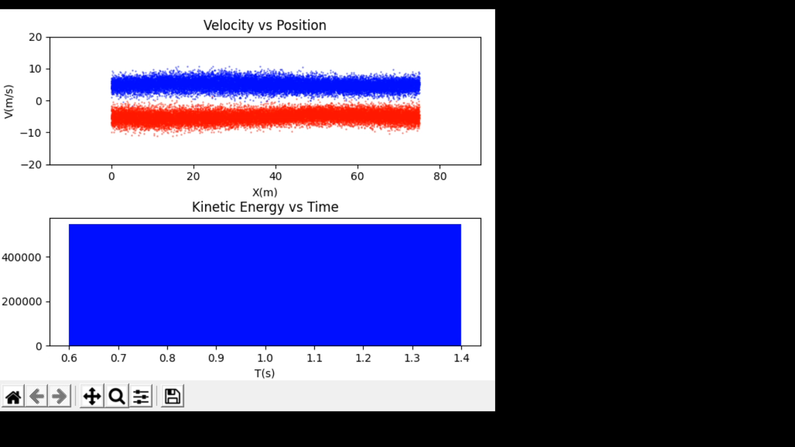
Results: Kinetic Energy vs. Time
A bar plot of the total kinetic energy of the system plotted with respect to time.
Along with phase space plot.
This plot with the oscillating kinetic energy shows us that the law of conservation of energy is not violated; showing that our simulation is correct.
K.E(J)

Slide 15
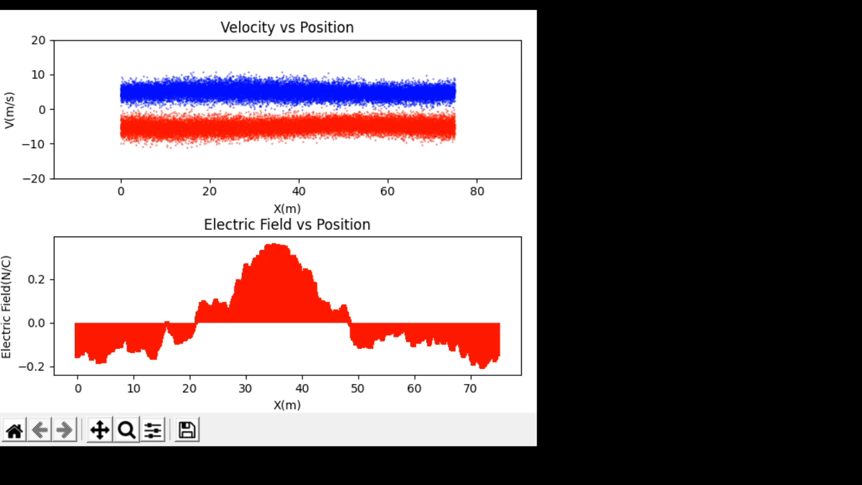
Results: Field distribution
Top: Phase space plot
Bottom: A plot of the Electric field plotted with respect to position
The Stability of structure of the structures can be explained
Using the Field plot; the vortices are formed when the field inverts

Slide 16
Conclusion
By means of PIC simulation we have observed that two electron beams can interact with each other.
This interaction can be explained through wave particle resonance (Interference of the two electron beams)
This shows that plasma (electron plasma in this case) takes on collective behaviour that is counter-intuitive compared to the behavior of individual particles

Slide 17
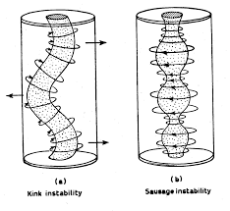
Appendix
Other examples of plasma instabilities

Slide 18
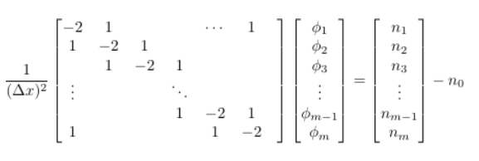
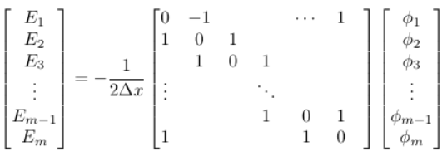
Appendix
Poisson’s equation in matrix
The electric field from
potential in matrix form

Slide 19
Appendix
The initial conditions used were:
Number of particles: 40000
Number of mesh cells: 600
Box size: 75 m
Beam velocity: 5 m/s
Beam width: 1.5m
Amplitude of perturbation: 10cm
The simulation was run for 100s with a hundred time steps each of 1s

Slide 20
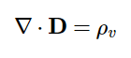
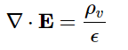
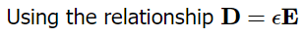
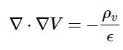

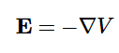
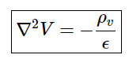
Poisson's Equation: 1D field calculation
I have used Poisson’s equation to calculate the potential at each grid point from the density binned at each grid point. The following the is the derivation of the differential equation.

